Slide 1
Programming for Problem Solving
By Boina Avinash Kumar (M.Tech CSI)
Assistant Professor

Slide 2
Outline
Algorithm
Properties
Examples
Flowchart
Examples

Slide 3
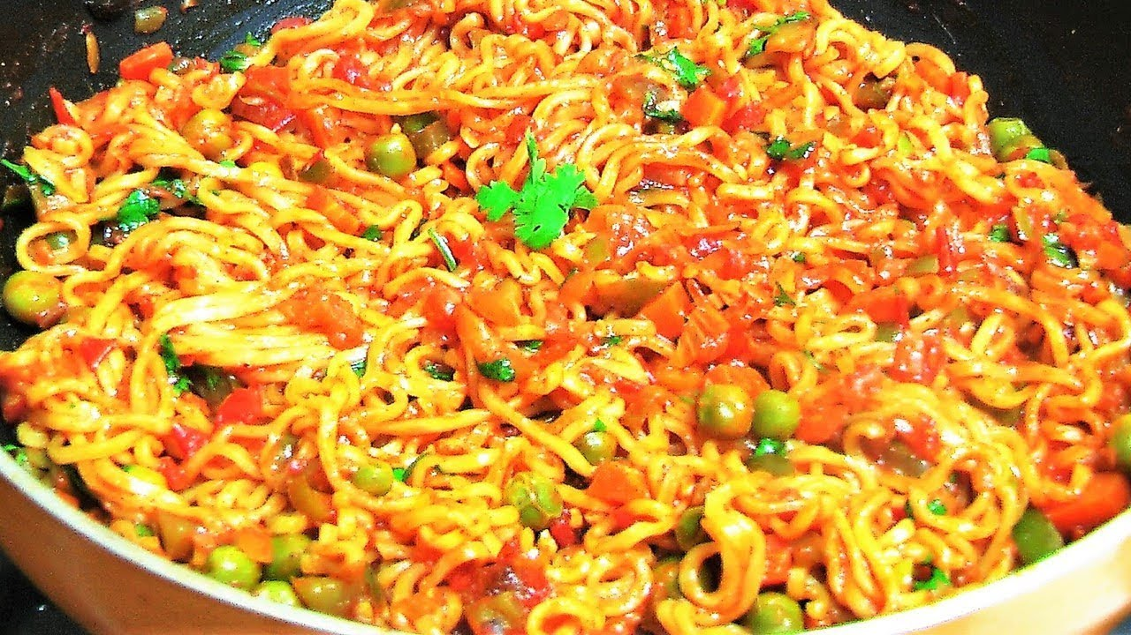

Slide 4
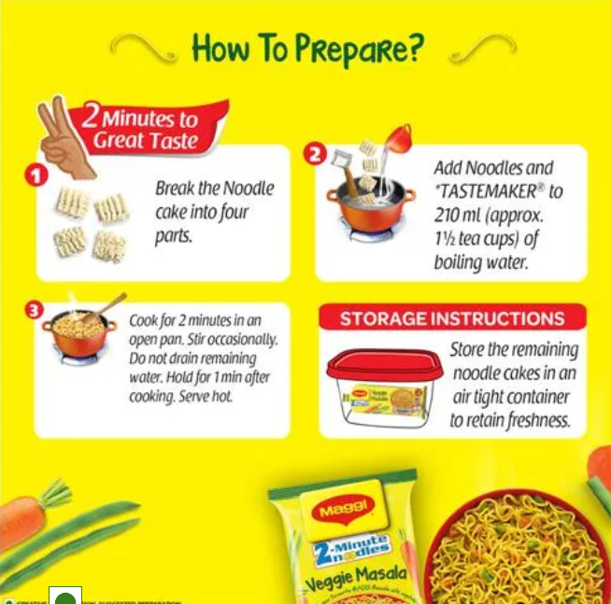

Slide 5
Algorithm
Step by step procedure for solving any problem is known as algorithm.
An algorithm is a finite set of instructions that, if followed, accomplishes a particular task.
An algorithm is a sequence of computational steps that transform the input into a valuable or required output.

Slide 6
Properties
Input: There are more quantities that are extremely supplied.
Output: At least one quantity is produced.
Definiteness: Each instruction of the algorithm should be clear and unambiguous.
Finiteness: The process should be terminated after a finite number of steps.
Effectiveness: Every instruction must be basic enough to be carried out theoretically or by using paper and pencil

Slide 7
Examples
Algorithm for Addition of two numbers
Step 1: Start
Step 2: Declare sum=0
Step 3: Read values for num1, num2
Step 4: Add num1 and num2 and assign the result to sum
Step 5: Display sum
Step 6: Stop

Slide 8
Examples
Algorithm to convert temperature from Celsius(°C) to Fahrenheit(°F)
Step 1: Start
Step 2: Declare F=0
Step 3: Read the temperature value in Celsius
Step 3: Applying Formula of Conversion i.e, F=(9*C)/5+32
Step 4: Print the Temperature in Fahrenheit
Step 5: Stop

Slide 9
Examples
Algorithm to find maximum of two numbers
Step 1: Start
Step 2: Read num1 and num2
Step 3: Compare num1 with num2
If num1 is greater than num2, num1 is greatest
else num2 is greater
Step 4: Print maximum number
Step 5: Stop

Slide 10
Examples
Algorithm to find even number
Step 1: Start
Step 2: Read a number n
Step 3: Check the number n is even or odd
If n%2 is equal to 0, then n is even
else n is odd number.
Step 4: Print a message that n is even number
Step 5: Stop

Slide 11
Examples
Algorithm to find sum of n numbers
Step 1: Start
Step 2: Declare sum=0,i=0
Step3:Read number num
Step 4: Repeat the step 5 to step 6 until i<=num
Step 5: sum=sum+i
Step 6: increment i
Step 7: Print sum
Step 8: Stop

Slide 12
Question
Write an algorithm for finding Area of a circle
Write an algorithm to convert temperature from Fahrenheit(°F) to Celsius(°C)
Write an algorithm to find distance between two points
Write an algorithm to find perimeter and area of a rectangle

Slide 13
Flowchart
A flowchart is a graphical representation of an algorithm.
Programmers often use it as a program-planning tool to solve a problem.
It makes use of symbols that are connected among them to indicate the flow of information and processing.
The process of drawing a flowchart for an algorithm is known as “flowcharting”.

Slide 14
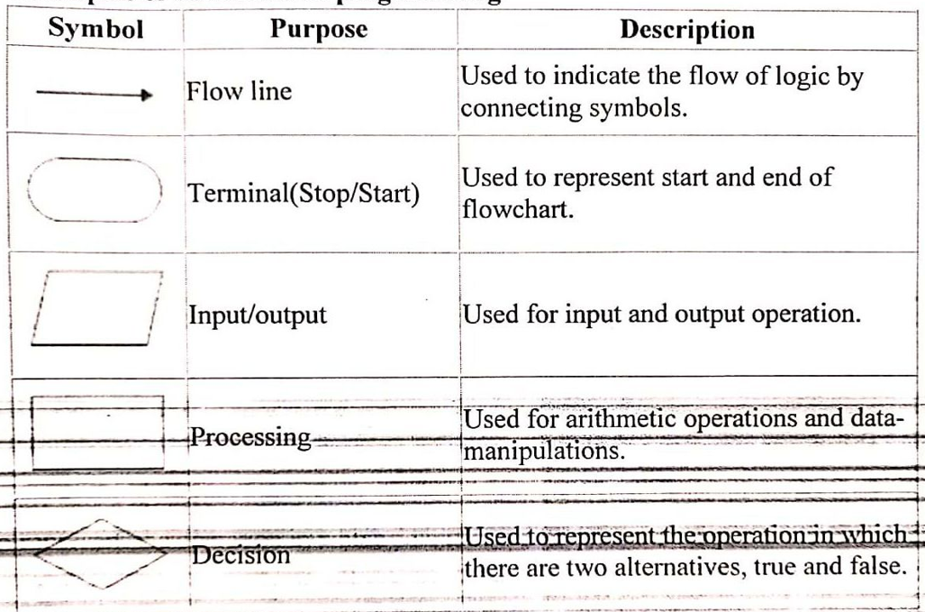
Symbols

Slide 15
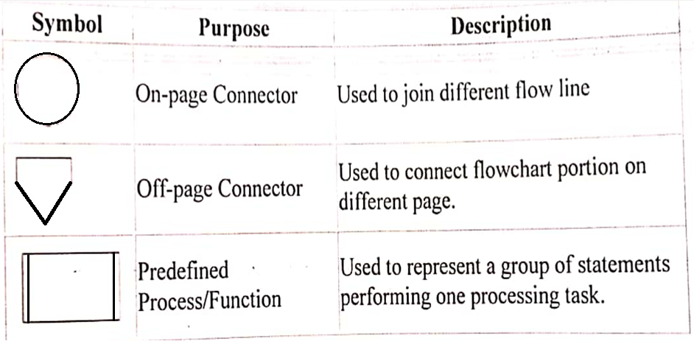
Symbols

Slide 16
Flowchart for Addition of two numbers

Slide 17
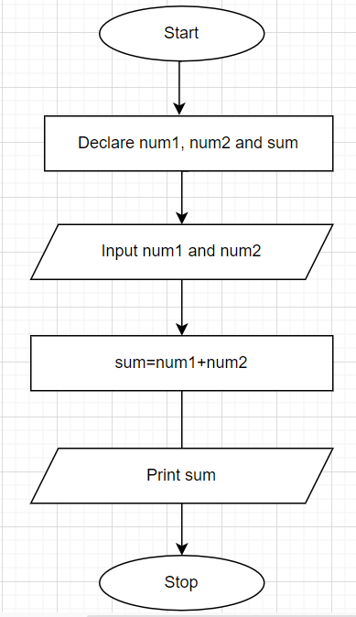

Slide 18
Flowchart to convert temperature from Celsius(°C) to Fahrenheit(°F)

Slide 19
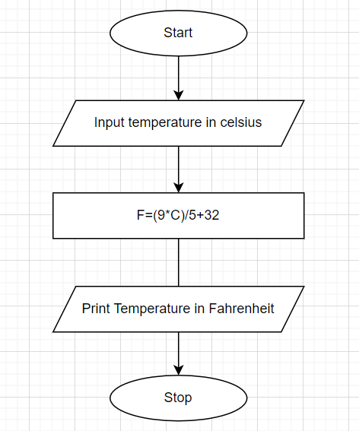

Slide 20
Flowchart to input two numbers from the user and display the largest of two numbers

Slide 21
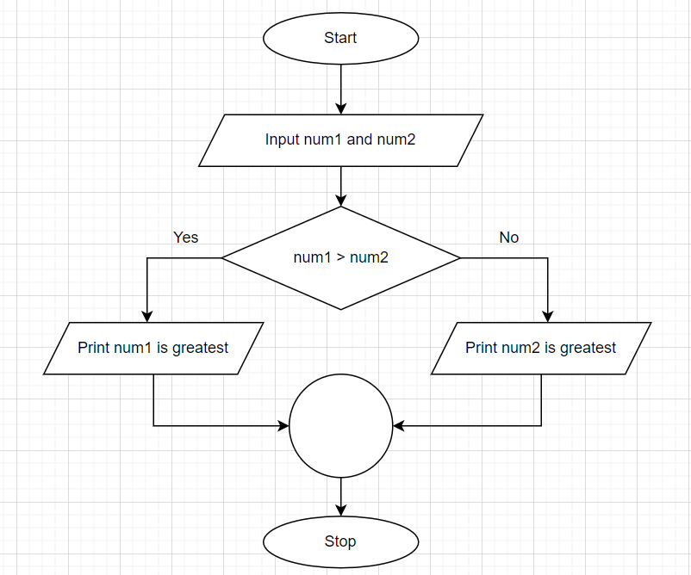

Slide 22
Flowchart to find even number

Slide 23
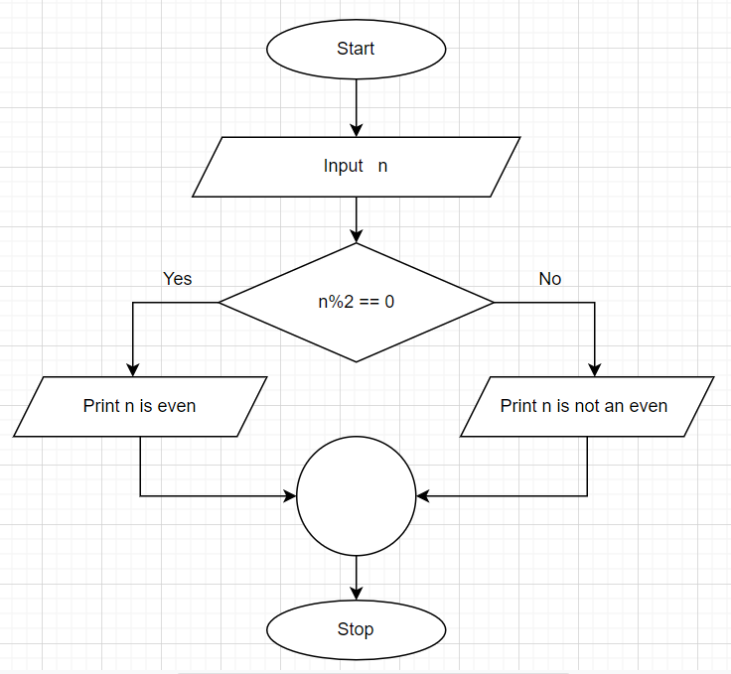

Slide 24
Thank You

